Slide 1


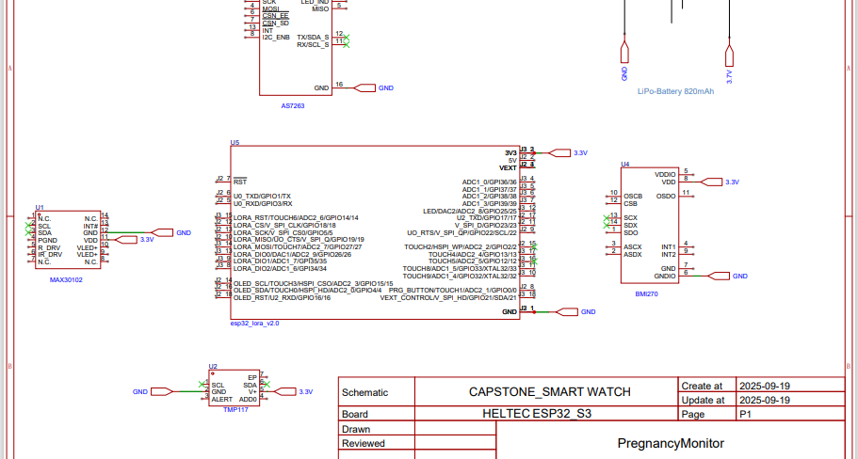
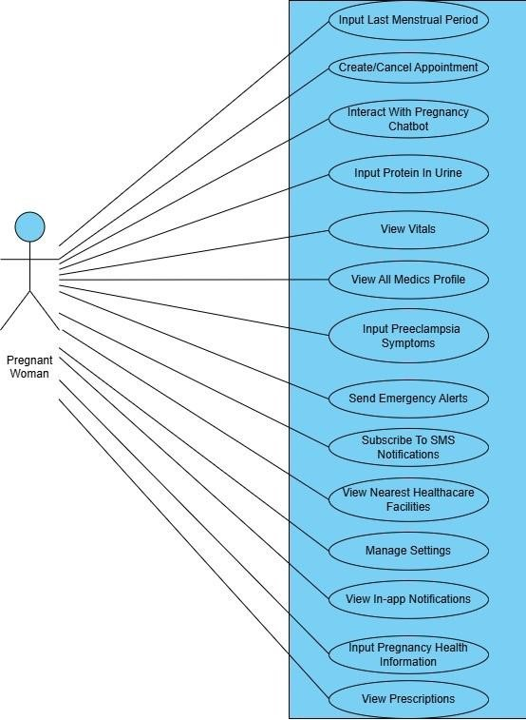
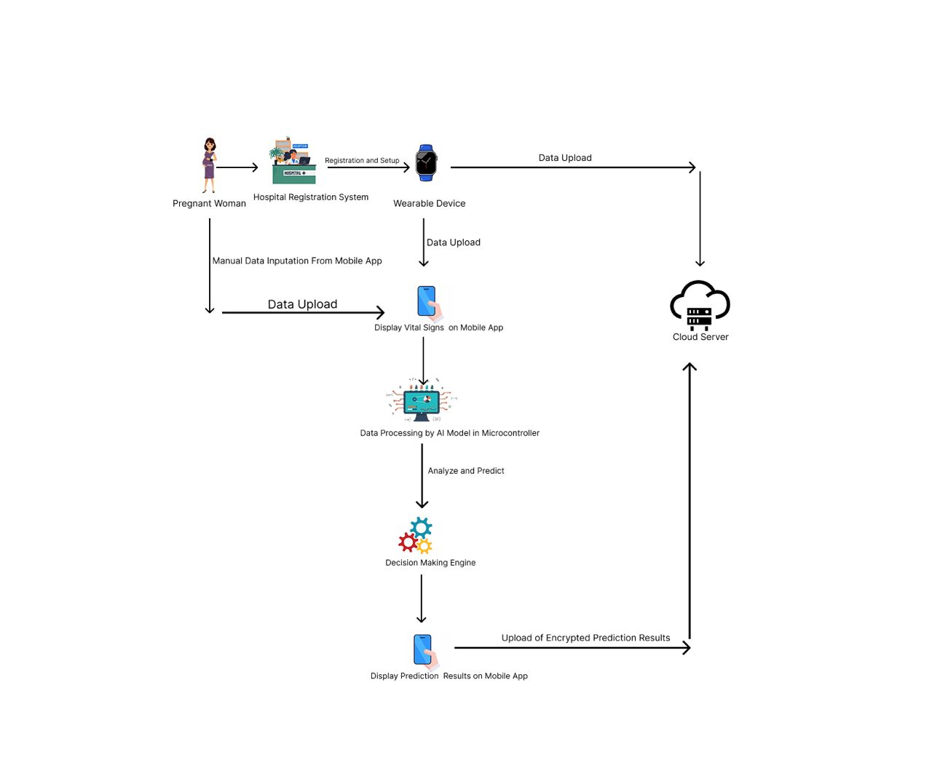
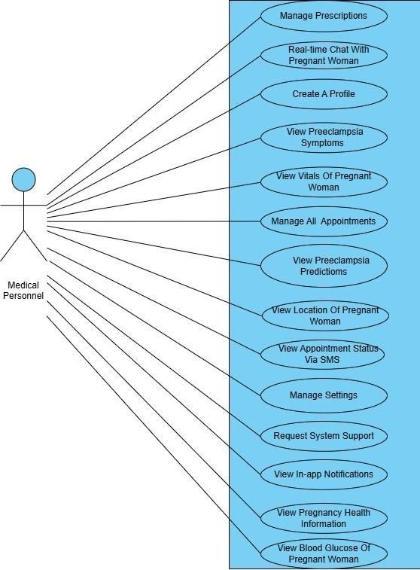
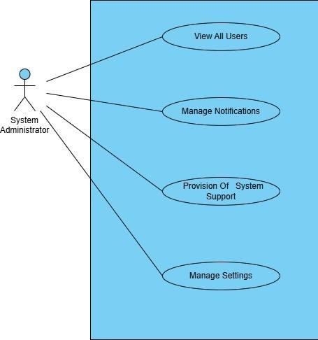
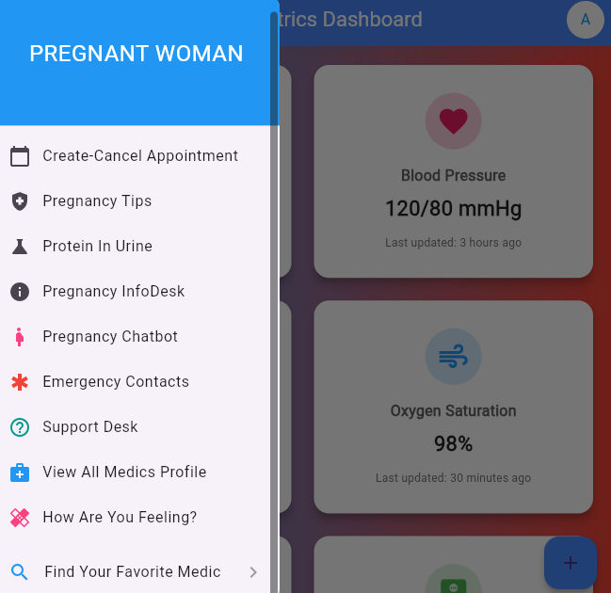
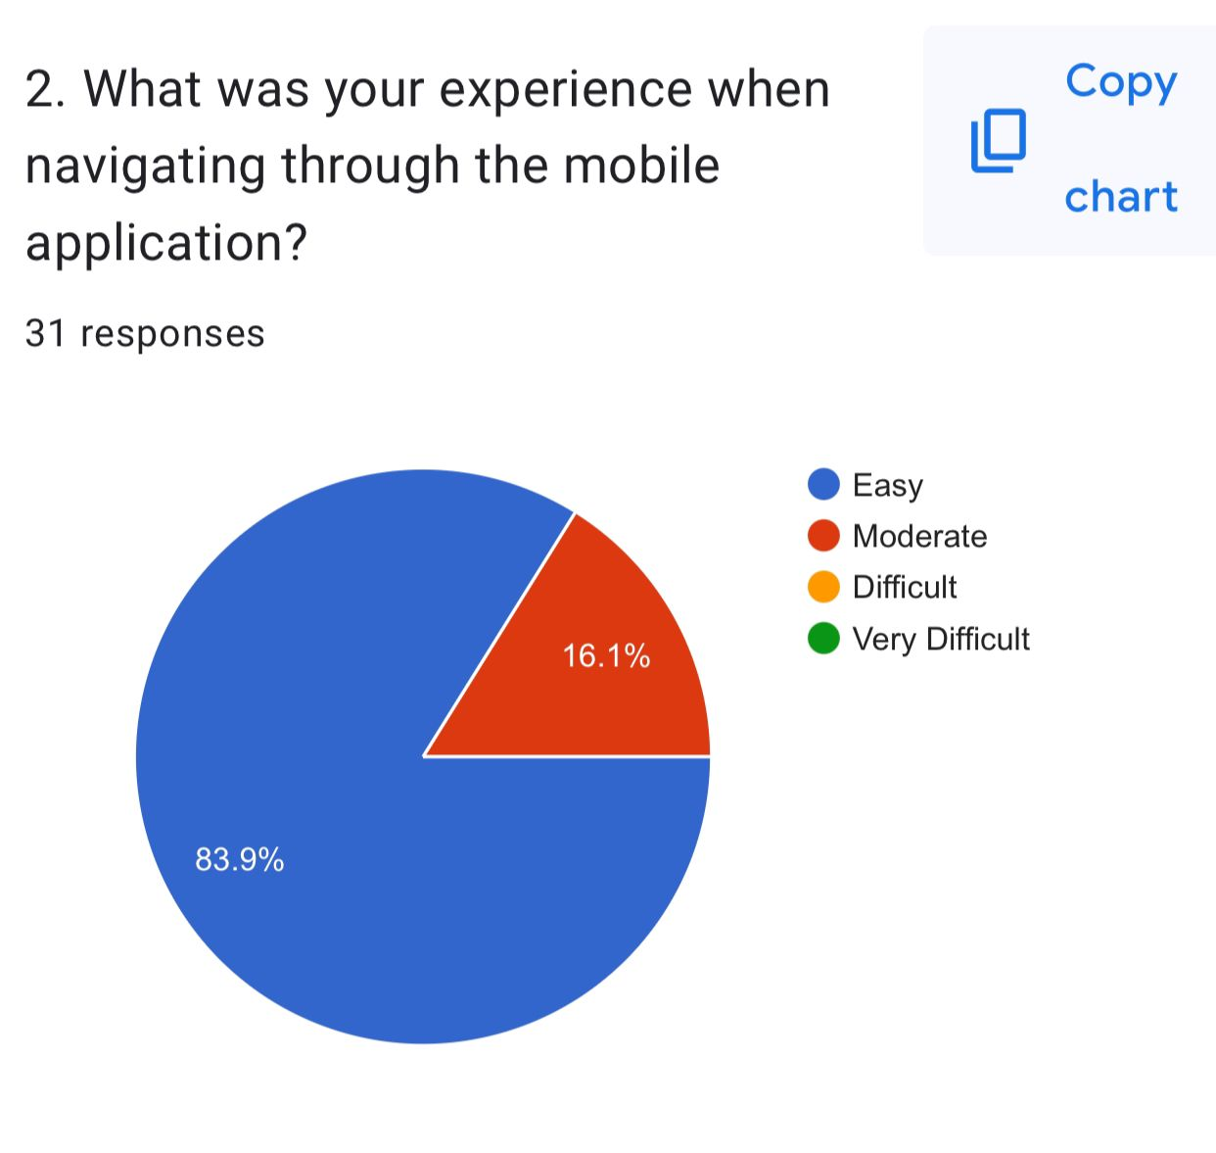
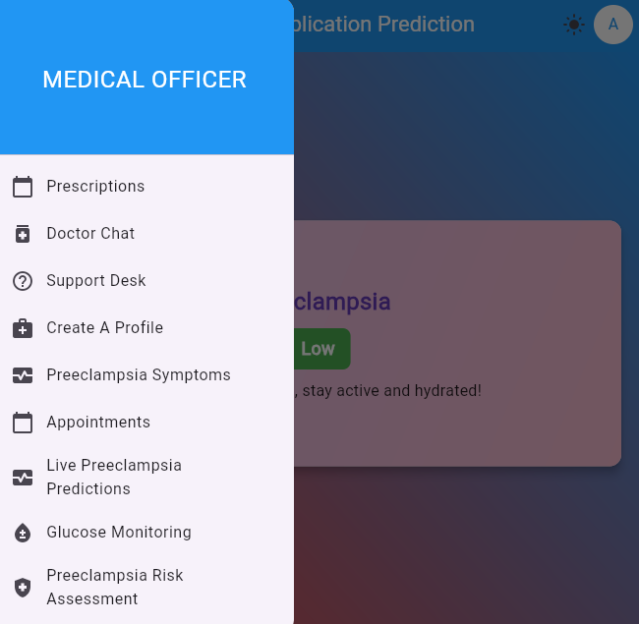
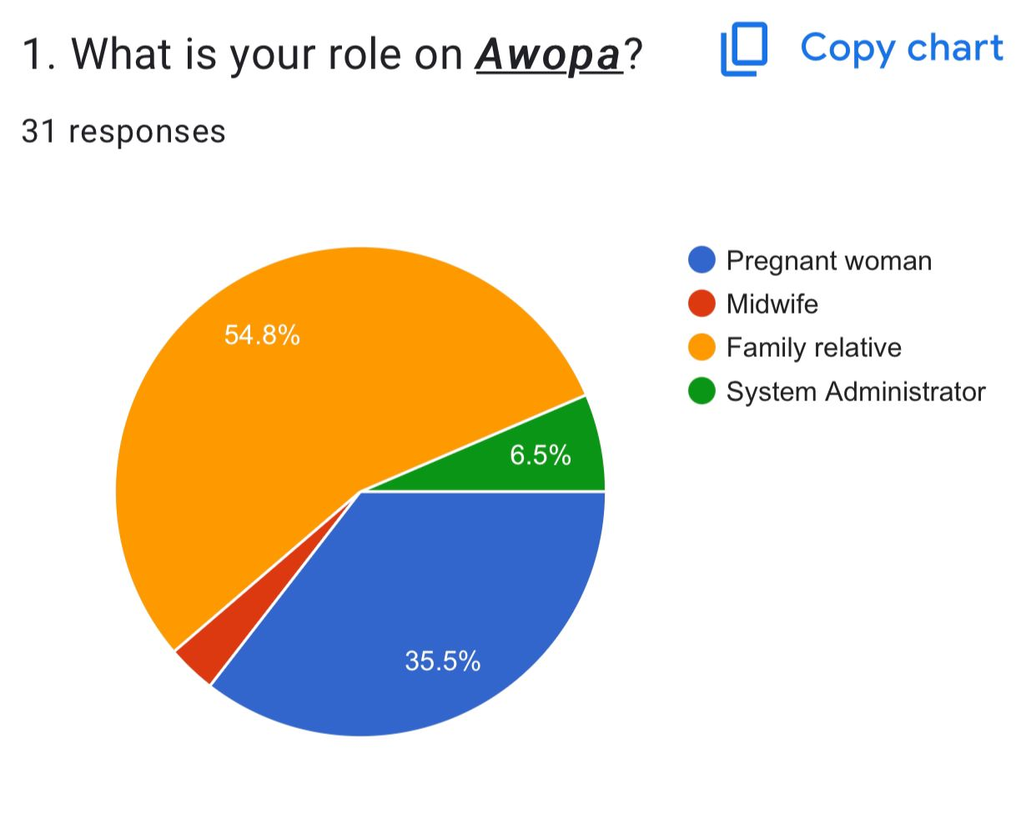
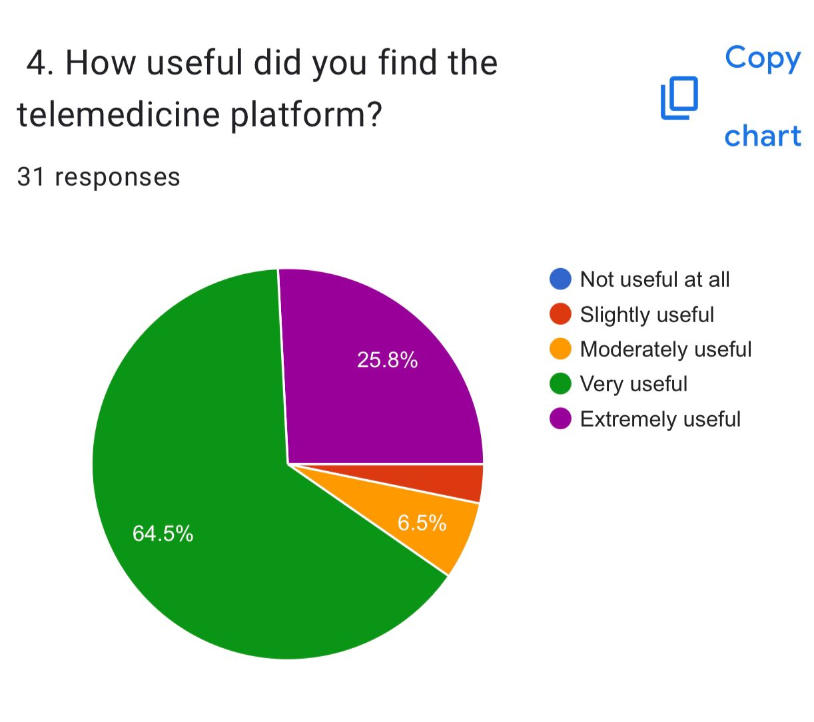
REMOTE MONITORING OF PREGNANT WOMEN IN GHANA USING A WEARABLE DEVICE AND A MOBILE APP
Einsteina Owoh, Nathaniel Adika, George Anane, Prof. Godfrey Mills,
Prof. Elsie Kaufman
Department of Computer Engineering, University of Ghana, Legon, Ghana
Emails: einsteinaowoh@gmail.com, nathanieladika@gmail.com
Introduction
Problem Definition
Objectives
Pregnancy comes with joy but also risks. Regular antenatal care is vital to track key health signs like blood pressure, heart rate, blood sugar, oxygen levels, and more. Without proper monitoring, mothers and babies face serious dangers such as preeclampsia, anemia, low birth weight, developmental delays, and even maternal mortality. By using technology for continuous monitoring, we can greatly reduce these risks and ensure safer pregnancies.
According to the WHO, over 40% of pregnancies in developing countries face serious health risks. ^{[1]}
Reports^{[1]} reveal that, in Ghana alone, 12% of female deaths (ages 15–49) in the last five years were linked to pregnancy complications, with 62% caused by late or poor medical intervention. Many mothers are unable to attend regular antenatal visits due to barriers such as time constraints, long travel distances, limited facilities, lack of reminders, poor-quality healthcare, and low awareness. These challenges greatly increase the risks for both mother and child.
To develop a wearable device to continuously monitor vitals, detect and trigger alerts in event of anomalies.
To develop a mobile and web app that will have a user-friendly interface system to acquire and visualize information for processing by the system
To train a machine learning model for risk prediction of pregnancy complications like preeclampsia and anemia long before standard detection window
System Design
The system is made up of three main features comprising: a wearable device for continuous vital monitoring, a mobile and web application for data visualization and management, and a machine learning model for early prediction of pregnancy complications.
Figure 2: Schematic Diagram of Circuit
Figure 3: Use Case Model Diagram For Pregnant Woman
Figure 1: System Architecture
Figure 4: Use Case Diagram of Medical Professional
Figure 5: Use case Diagram of System Administrator
Figure 6: Pregnant Woman Dashboard
System Development and Testing
The system was developed in stages, starting with sensor testing on a breadboard, later transferred to a perfboard and enclosed in a 3D-printed wearable casing. The ESP32 microcontroller was programmed in C++ for stable sensor communication and data transfer. A machine learning model was trained and integrated into the mobile app backend, while the frontend was built with Flutter and connected to a NestJS backend and React web interface. Final testing showed the system could capture vitals, transmit data, and provide reliable predictions when compared with real hospital diagnoses.
To evaluate the mobile application, we conducted a structured questionnaire with selected participants to measure usability, functionality, ease of use, design, and overall satisfaction. This quantitative approach provided objective feedback on user experience and highlighted areas for improvement. The results of the survey are summarized in the figures below.
Figure 9: Results On How easy it was to use the App.
Figure 7: Medical Professional Dashboard
Figure 8: Results From Users
Figure 10:Results On How relevant the
telemedicine Platform was.
was.
Conclusion
Future Extension
References
I can conclude that all project objectives were successfully achieved. A wearable device for continuous monitoring was developed and integrated with a mobile and web application, providing real-time visualization and data management. The incorporation of a machine learning model enabled early prediction of pregnancy complications, while live testing confirmed the system’s accuracy and reliability. Overall, the solution meets the needs of both patients and healthcare providers, strengthening maternal care and reducing pregnancy-related risks.
Reducing the device size for improved comfort.
Acquiring real-world data to strengthen model training.
Expanding the scope to serve general users.
[[1] Y. K. Wiafe, A. Asamoah, P. Akweongo, and A. Kumah, "Factors Affecting Pregnancy Complications in Ghana," Global J. Quality Safety Healthcare, vol. 7, no. 4, pp. 156-161, 2024.
[2] T. Tabassum, S. Podder, and S. T. S. Rafid, "A Comprehensive Framework for Wearable Module for Prenatal Health Monitoring and Risk Detection," IEEE Int. Conf. Women Innov., Technol. Entrepreneurship (ICWITE), pp. 283-288, 2024.

